Slide 1
12 14 factor app
15/04/2022

Slide 2
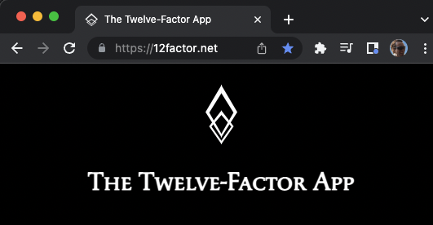
The twelve-factor app

Slide 3
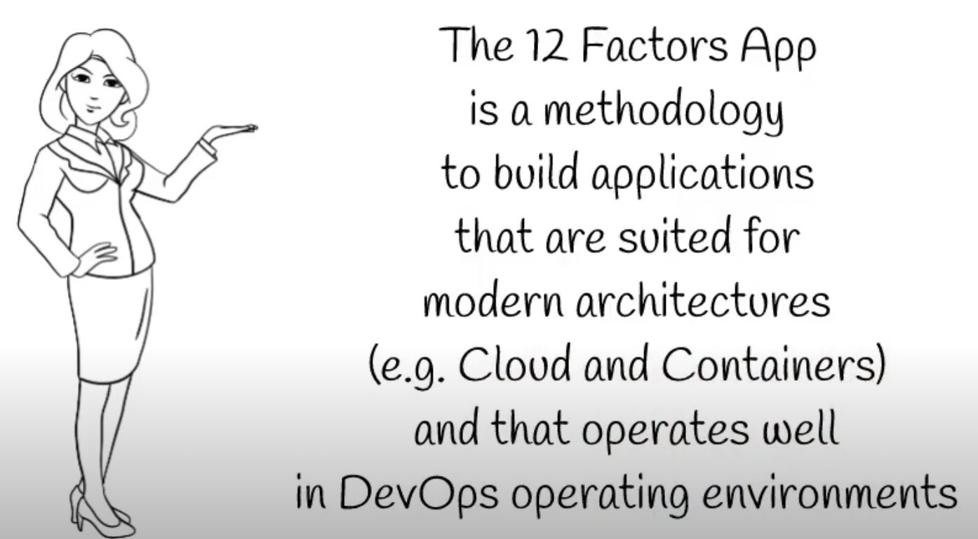
what

Slide 4
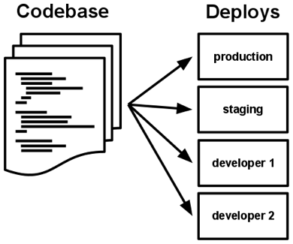
I. Codebase
One codebase tracked in revision control, many deploys
A codebase is any single repo or any set of repos who share a root commit

Slide 5
I. Codebase
Use version control
1 Deployment : 1 Repo
deploy as whole or not deploying at all
one repo many deployments in different envs
for multi-module projects use git submodule
discouraging monorepo containing different device/apps implementation (eg. mobile app)

Slide 6




II. Dependencies
Explicitly declare and isolate dependencies
A twelve-factor app never relies on implicit existence of system-wide packages

Slide 7
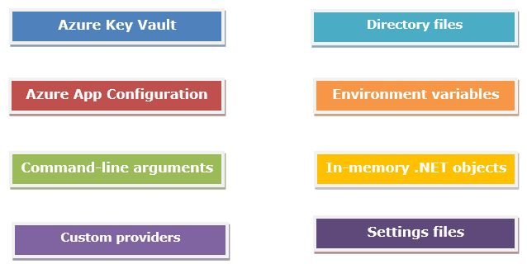
III. Config
Store config in the environment
strict separation of config from code

Slide 8
III. Config
Never, ever, store config in the source code
Configurations are kept separate from the code.
Store configuration in the environment
You don't have to redeploy or repackage your application when you have to change something in the configuration
Store configurations in git and push it via pipeline to the appropriate backing service
Configurations must be treated as environment-dependant
Config should be injected into the app at runtime

Slide 9
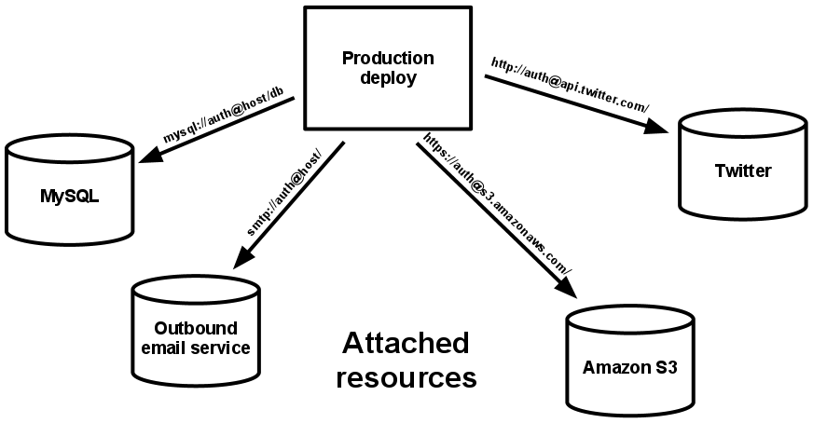
IV. Backing services
Treat backing services as attached resources
The code for a twelve-factor app makes no distinction between local and third party services

Slide 10
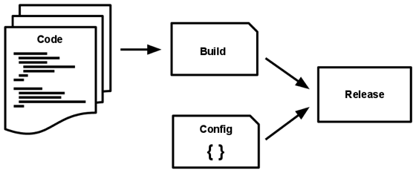
V. Build, release, run
Strictly separate build and run stages
The twelve-factor app uses strict separation between the build, release, and run stages

Slide 11
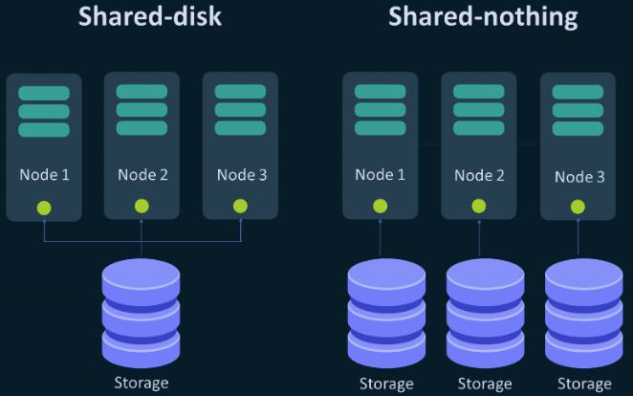
VI. Processes
Execute the app as one or more stateless processes
Twelve-factor processes are stateless and share-nothing

Slide 12
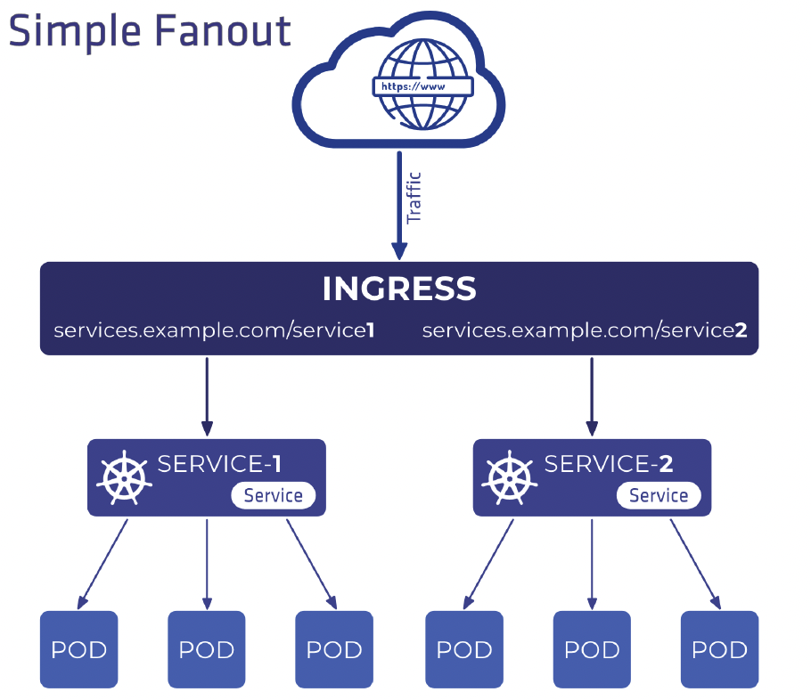
VII. Port binding
Export services via port binding
The twelve-factor app is completely self-contained

Slide 13
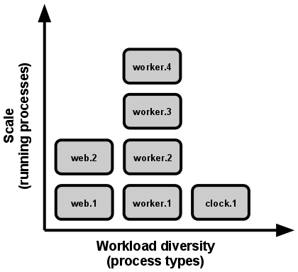
VIII. Concurrency
Scale out via the process model
In the twelve-factor app, processes are a first class citizen: the unix process model for running service daemons.

Slide 14
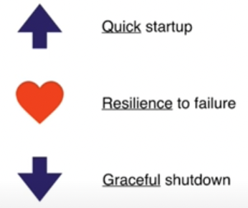
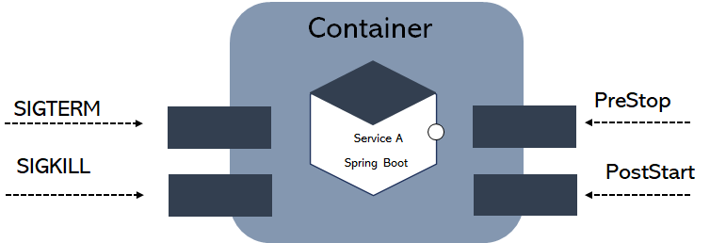
IX. Disposability
Maximize robustness with fast startup and graceful shutdown
The twelve-factor app’s processes are disposable, meaning they can be started or stopped at a moment’s notice

Slide 15
X. Dev/prod parity
Keep development, staging, and production as similar as possible
 | Traditional app | Twelve-factor app
Time between deploys | Weeks | Hours
Code authors vs code deployers | Different people | Same people
Dev vs production environments | Divergent | As similar as possible
The twelve-factor developer resists the urge to use different backing services between development and production,

Slide 16
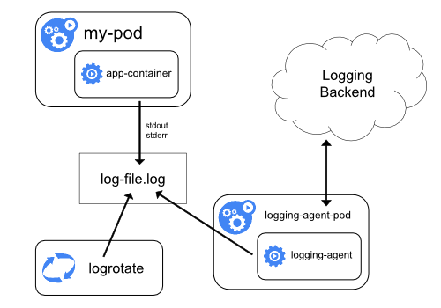
XI. Logs
Treat logs as event streams
https://kubernetes.io/docs/concepts/cluster-administration/logging/
A twelve-factor app never concerns itself with routing or storage of its output stream

Slide 17
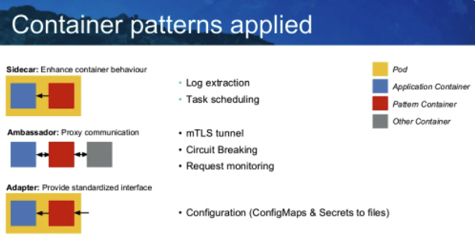
XII. Admin processes
Run admin/management tasks as one-off processes
Running database migrations, console, one-time scripts

Slide 18
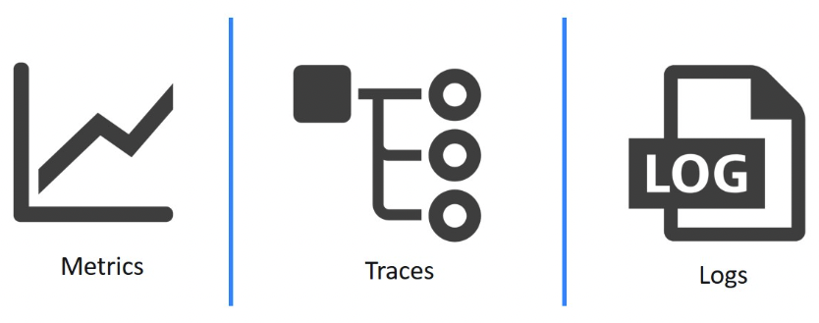
XII. Observability
Internal states of a system can be inferred from knowledge of its external outputs

Slide 19

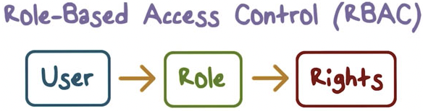

XIV. security
Modern apps should take security-first

Slide 20
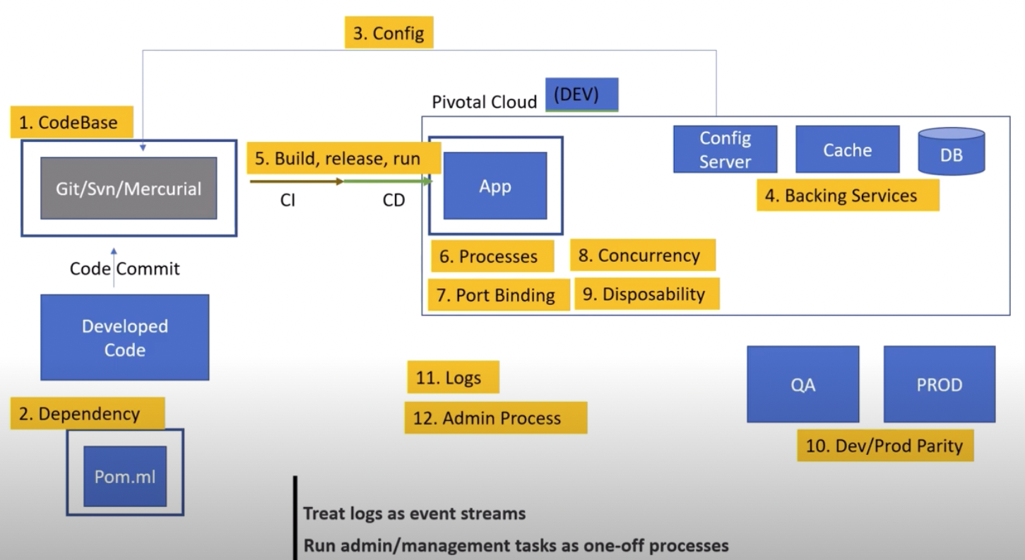
The global view

Slide 21
references
The twelve-factor app
12 Factor App - #6MinuteSaturdays #1 | Tech Primers
12 Factors App | MicroServices Architecture | Cloud Native Best Practices
Introduction to 12 Factor App
5 Years of 12 Factor Apps by Joe Kutner

